Slide 1
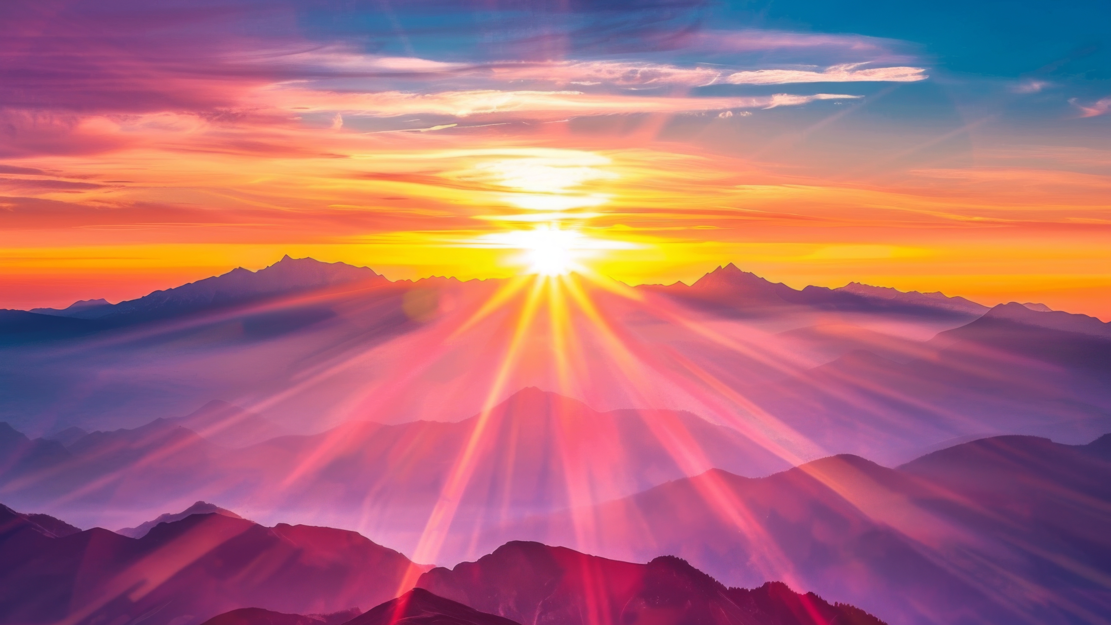

Slide 2
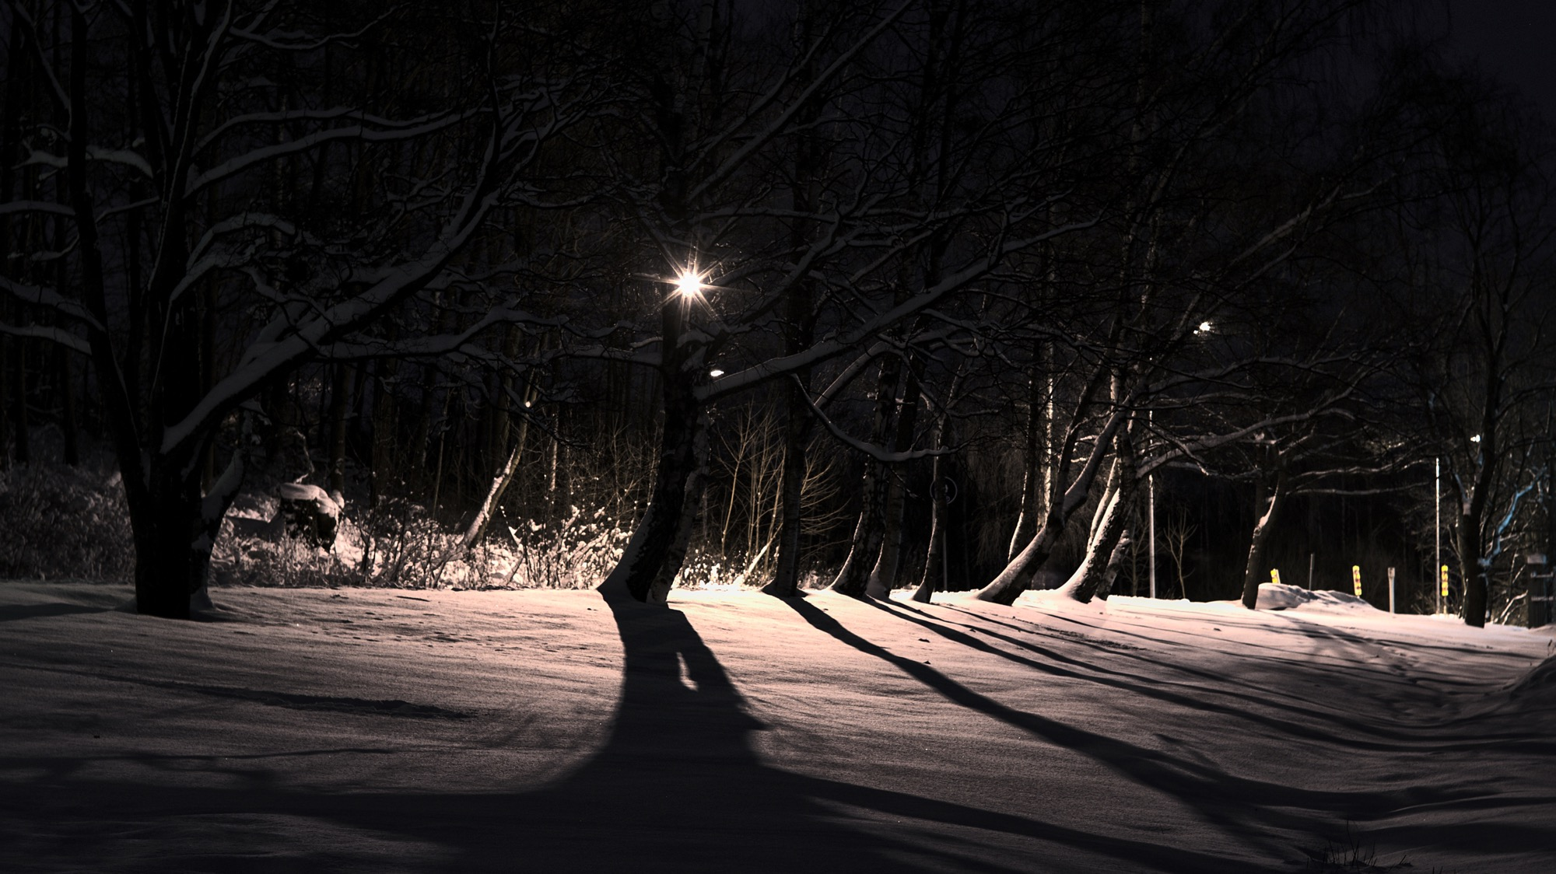
Un soir de neige
petite cantate de chambre pour chœur a cappella sur des poèmes de Paul Éluard
Francis Poulenc

Slide 3
I. De grandes cuillers de neige
De grandes cuillers de neige Ramassent nos pieds glacés Et d’une dure parole Nous heurtons l’hiver têtu
Great scoops of snow
Shovel up our frozen feet
And with harsh word
We stumble into stubborn winter

Slide 4
I. De grandes cuillers de neige
Chaque arbre a sa place en l’air
Chaque roc son poids sur terre
Chaque ruisseau son eau vive
Nous nous n’avons pas de feu
Each tree has its place in the sky
Each rock its weight on earth
Each stream its spring
We have no fire

Slide 5
II. La bonne neige
La bonne neige le ciel noir
Les branches mortes la détresse
De la forêt pleine de pièges
Honte à la bête pourchassée
La fuite en flêche dans le coeur
Fine snow dark sky
Dead branches the torment
From the forest strewn with traps
Shame on the hunted animal
Fleeing swiftly as an arrow through the heart

Slide 6
II. La bonne neige
Les traces d’une proie atroce
Hardi au loup et c’est toujours
Le plus beau loup et c’est toujours
Le dernier vivant que menace
La masse absolue de la mort
The tracks of a terrible prey
That fears no wolf
And it is always the most beautiful
And it is always the last left alive
That is stalked by the full weight of death

Slide 7
II. La bonne neige
La bonne neige le ciel noir
Les branches mortes la détresse
De la forêt pleine de pièges
Honte à la bête pourchassée
La fuite en flêche dans le coeur
Fine snow dark sky
Dead branches the torment
From the forest strewn with traps
Shame on the hunted animal
Fleeing swiftly as an arrow through the heart

Slide 8
III. Bois meutri
Bois meurtri
Bois perdu d'un voyage en hiver
Navire où la neige prend pied
Bois d'asile
Bois mort où sans espoir je rêve
De la mer aux miroirs crevés
The slaughtered wood
The wood lost on a winter voyage
A ship upon which snow takes hold
The wood that is a sanctuary
The dead wood, where with all hope lost
I dream of the sea of splintered mirrors

Slide 9
III. Bois meutri
Un grand moment d'eau froide a saisi les noyés
La foule de mon corps en souffre
Je m'affaiblis je me disperse
J'avoue ma vie j'avoue ma mort j'avoue autrui
Bois meurtri, bois perdu
Bois d'asile, bois mort
One great moment in the cold water seized the drowned men
My scrambled body is racked with pain
I grow weaker I am fading away
I acknowledge my life my death the rest of the world
The slaughtered wood, the lost wood
The wood that is a sanctuary, the dead wood

Slide 10
IV. La nuit le froid la solitude
La nuit le froid la solitude
On m'enferma soigneusement
Mais les branches cherchaient leur voie dans la prison
Night, cold, solitude
Closed carefully in upon me
But the branches sought out their path in the prison

Slide 11
IV. La nuit le froid la solitude
Autour de moi l’herbe trouva le ciel
On verrouilla le ciel ma prison s’écroula
Le froid vivant le froid brûlant m’eut bien en main
Around me the grass found the sky
The sky was bolted shut my prison came tumbling down
The living cold the burning cold holds me firmly in its hand

Slide 12
O radiant dawn
James Macmillan
O radiant dawn,
splendour of eternal light,
sun of justice:
come,
shine on those who dwell in darkness
and the shadow of death.

Slide 13
O radiant dawn
Isaiah had prophesied:
“The people who walked in darkness
have seen a great light;
Upon those who dwelt in the land of gloom
a light has shone.”

Slide 14
O radiant dawn
O radiant dawn,
splendour of eternal light,
sun of justice:
come,
shine on those who dwell in darkness
and the shadow of death.
Amen.

Slide 15
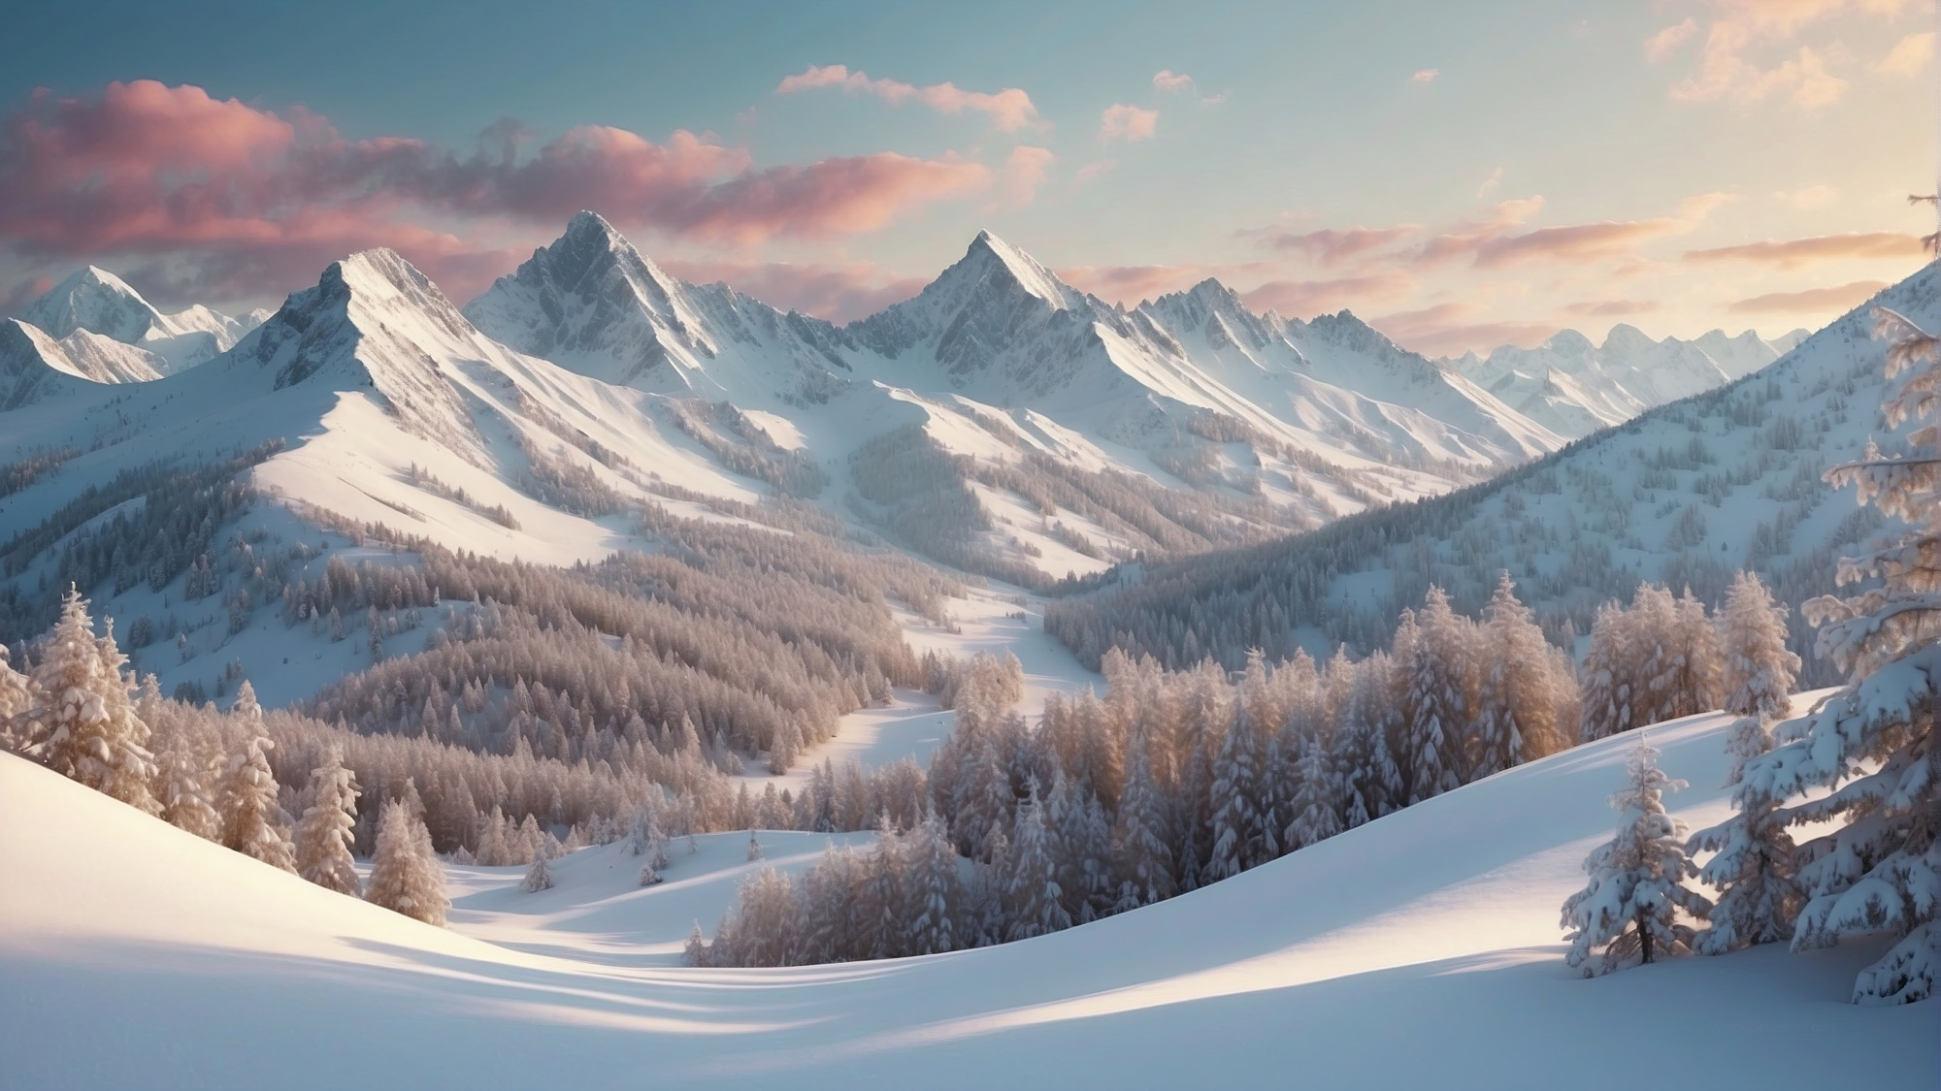
A winter day
Sarah Quartel

Slide 16
I. Timid star
Sara Teasdale
Fields beneath a quilt of snow
From which the rocks and stubble peep,
And in the west a shy white star
That shivers as it wakes from sleep.

Slide 17
II. A winter dawn
Lucy Maud Montgomery
Above the marge of night a star still shines,
And on the frosty hills the sombre pines
Harbour an eerie wind that crooneth low
Over the glimmering wastes of virgin snow.
Through the pale arch of orient the morn
Comes in a milk-white splendour newly-born,
A sword of crimson cuts in twain the gray
Banners of shadow hosts, and lo, the day!

Slide 18
III. Into morning

Slide 19
IV. A winter day
Lucy Maud Montgomery
Wide, sparkling fields snow-vestured lie
Beneath a blue, unshadowed sky.
Life hath a jollity and zest,
A poignancy made manifest;
Laughter and courage have their way
At noontide of a winter's day.

Slide 20
IV. A winter day
Lucy Maud Montgomery
A glistening splendour crowns the woods
And bosky, whistling solitudes;
In hemlock glen and reedy mere
The tang of frost is sharp and clear.
Life hath a jollity and zest,
A poignancy made manifest;
Laughter and courage have their way
At noontide of a winter's day.

Slide 21
IV. A winter day
Lucy Maud Montgomery
Faint music rings in wold and dell,
The tinkling of a distant bell,
Where homestead lights with friendly glow
Glimmer across the drifted snow.
Life hath a jollity and zest,
A poignancy made manifest;
Laughter and courage have their way
At noontide of a winter's day.
Wide, sparkling fields…

Slide 22
V. Snow toward evening
Melville Cane
Suddenly the sky turned grey,
The day,
Which had been bitter and chill,
Grew soft and still.
Quietly
From some invisible blossoming tree
Millions of petals cool and white
Drifted and blew,
Lifted and flew,
Fell with the falling night.

Slide 24
O nata lux de lumine
Thomas Tallis
O nata lux de lumine,
Jesu redemptor saeculi,
Dignare clemens supplicum
Laudes precesque sumere.
O light born of light,
Jesus, redeemer of the world,
with loving-kindness receive
suppliant praise and prayer.

Slide 25
O nata lux de lumine
Qui carne quondam contegi
Dignatus es pro perditis,
Nos membra confer effici
Tui beati corporis.
Thou who once deigned
to be clothed in flesh
for the sake of the lost,
grant us to be members of thy blessed body.

Slide 26
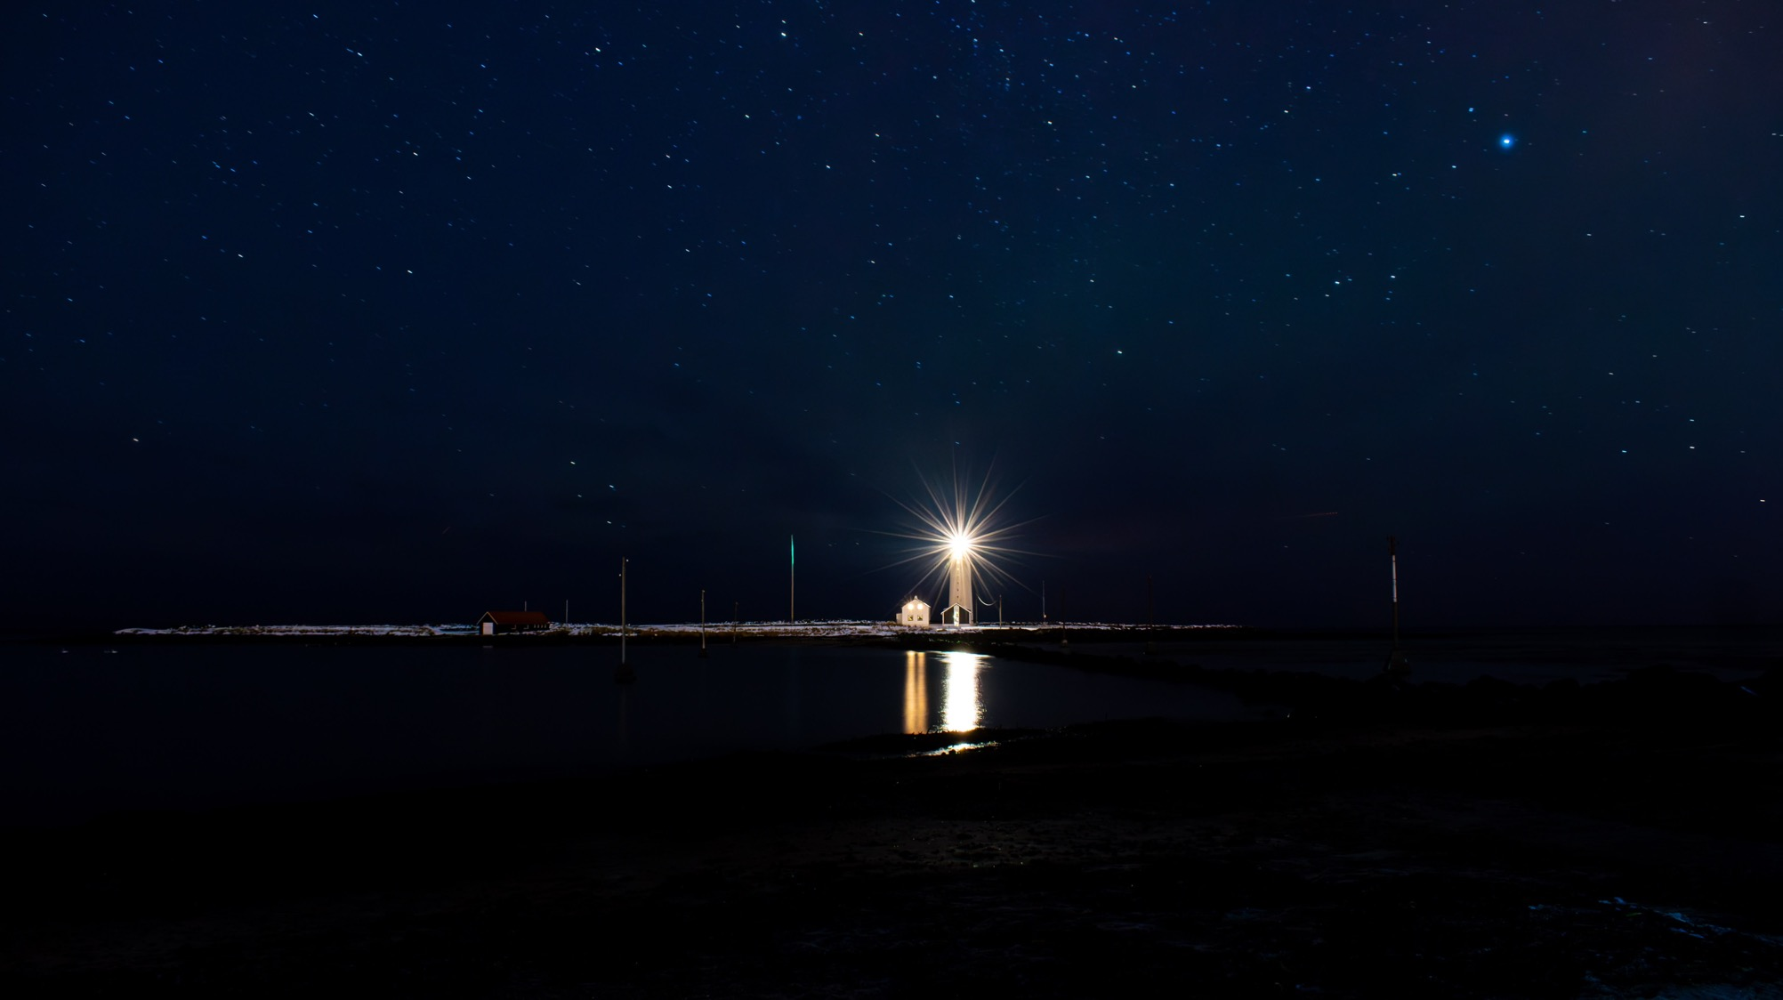
O nata lux de lumine
Thomas Tallis
Te lucis ante terminum
Thomas Tallis

Slide 27
Te lucis ante terminum
Te lucis ante terminum,
Rerum Creator poscimus,
Ut solita clementia
Sis præsul ad custodiam.
Thou, light before the end,
Creator of the world, we pray
That you will be our guard and custodian,
With your usual clemency.

Slide 28
Te lucis ante terminum
Te corda nostra somnient,
te per soporem sentiant,
tuamque semper gloriam
vicina luce concinant.
Our hearts dream of you,
We sense you in our sleep,
And we always sing your glory
close to the light.

Slide 29
Te lucis ante terminum
Vitam salubrem tribue,
Nostrum calorem refice,
Tætram noctis caliginem
Tua collustret claritas.
Let dreams and nightly phantasms
Depart into the distance;
And suppress our enemy
So that our bodies are not polluted.

Slide 30
Te lucis ante terminum
Præsta, Pater omnipotens,
Per Iesum Christum Dominum,
Qui tecum in perpetuum
Regnat cum Sancto Spiritu.
Grant this, almighty Father,
Through Jesus Christ our Lord,
who reigns with you forever
with the Holy Spirit.

Slide 31
Laudibus in sanctis
William Byrd
Laudibus in sanctis Dominum celebrate supremum:
Firmamenta sonent inclita facta Dei.
Inclita facta Dei cantate, sacraque potentis
Voce potestatem sæpe sonate manus.
Celebrate the Lord most high in holy praises:
Let the firmament echo the glorious deeds of God.
Sing ye the glorious deeds of God, and with holy voice
Sound forth oft the power of his mighty hand.

Slide 32
Laudibus in sanctis
Magnificum Domini cantet tuba martia nomen:
Pieria Domino concelebrate lira.
Laude Dei resonent resonantia tympana summi:
Alta sacri resonent organa laude Dei.
Let the warlike trumpet sing the great name of the Lord:
Celebrate the Lord with Pierian lyre.
Let resounding timbrels ring to the praises of the most-high God,
Lofty organs peal to the praise of the holy God.

Slide 33
Laudibus in sanctis
Hunc arguta canant tenui psalteria corda,
Hunc agili laudet læta chorea pede.
Concava divinas effundant cymbala laudes,
Cymbala dulcisona laude repleta Dei.
Omne quod æthereis in mundo vescitur auris
Alleluia canat tempus in omne Deo.
Him let melodious psalteries sing with fine string,
Him let joyful dance praise with nimble foot.
Let hollow cymbals pour forth divine praises,
Cymbals filled with the sweet-sounding praise of God.
Let everything in the world that feeds upon the air of heaven
Sing Alleluia to God for evermore.

Slide 34
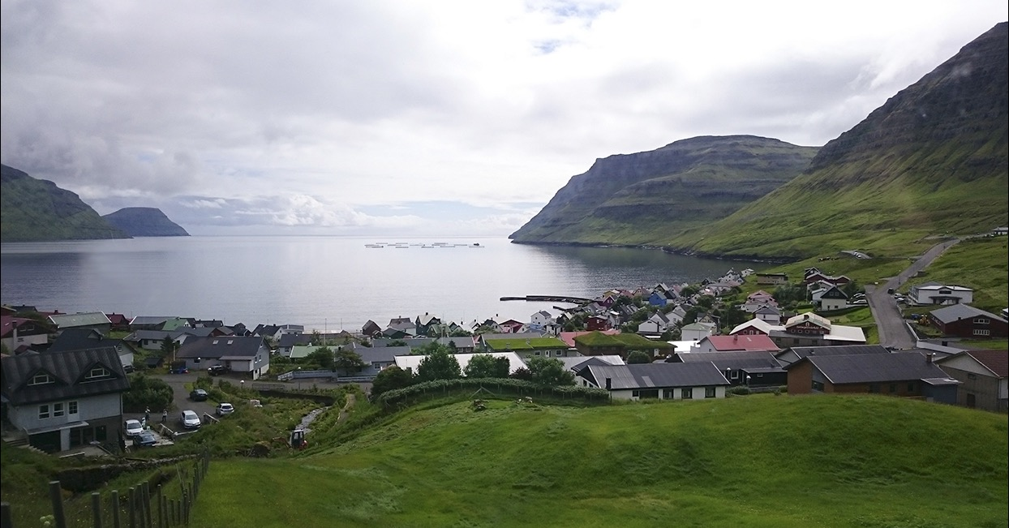
Gøta
Peder Karlsson
The Real Group

Slide 35
The lark in the clear air
Andrew Carter
Dear thoughts are in my mind,
And my soul soars enchanted
As I hear the sweet lark sing
In the clear air of the day.
For a tender beaming smile
To my hope has been granted,
And tomorrow she shall hear
All my fond heart would say.

Slide 36
The lark in the clear air
I shall tell her all my love,
All my soul's adoration,
And I think she will hear me
And will not say me nay.
It is this that gives my soul
All its joyous elation,
As I hear the sweet lark sing
In the clear air of the day.

Slide 37
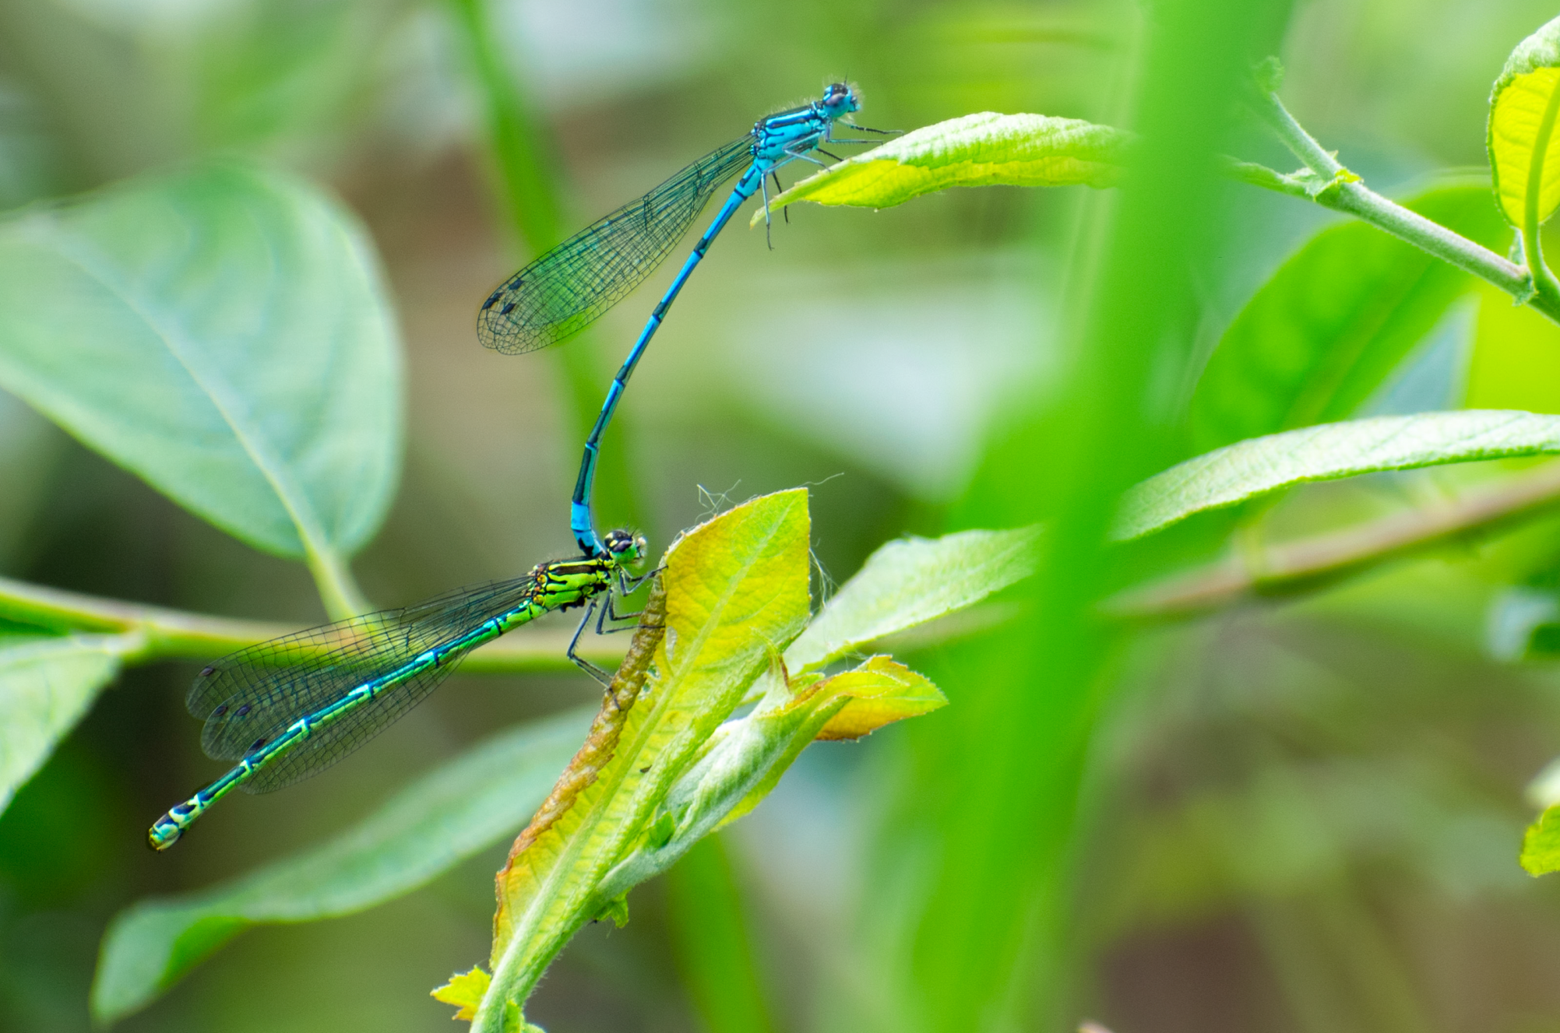
Let’s do it
Cole Porter
arranged by David Blackwell

Slide 38
Let’s do it
When the little bluebird,
Who has never said a word,
Starts to sing: 'Spring, Spring';
When the little bluebell,
In the bottom of the dell,
Starts to ring: 'Ding, Ding';
When the little blue clerk,
In the middle of his work,
Starts a tune to the moon up above,
It is nature, that's all,
Simply telling us to fall in love.

Slide 39
Let’s do it
And that’s why…
Birds do it, bees do it,
Even educated fleas do it;
Let's do it, let's fall in love.
In Spain, the best upper sets do it,
Lithuanians and Letts do it,
Let's do it, let's fall in love.

Slide 40
Let’s do it
The Dutch in old Amsterdam do it,
Not to mention the Finns;
Folks in Siam do it:
Think of Siamese twins.
Some Argentines without means do it;
People say in Boston even beans do it.
Let's do it, let's fall in love.

Slide 41
Let’s do it
Romantic sponges, they say, do it,
Oysters down in Oyster Bay do it;
Let's do it, let's fall in love.
Cold Cape Cod clams, 'gainst their wish, do it,
Even lazy jellyfish do it;
Let's do it, let's fall in love.

Slide 42
Let’s do it
Electric eels, I might add, do it,
Though it shocks ’em, I know.
Why ask if shad do it?
Waiter bring me shad roe.
In shallow shoals English soles do it,
Goldfish in the privacy of bowls do it;
Let's do it, let's fall in love.

Slide 43
Blow, blow, thou winter wind
George Shearing
Blow, blow, thou winter wind,
Thou art not so unkind
As man’s ingratitude;
Thy tooth is not so keen,
Because thou art not seen,
Although thy breath be rude.
Heigh-ho! sing, heigh-ho! unto the green holly:
Most friendship is feigning, most loving mere folly:
Then, heigh-ho, the holly!
This life is most jolly.

Slide 44
Blow, blow, thou winter wind
Freeze, freeze, thou bitter sky,
That dost not bite so nigh
As benefits forgot:
Though thou the waters warp,
Thy sting is not so sharp
As friend remembered not.
Heigh-ho! sing, heigh-ho! unto the green holly:
Most friendship is feigning, most loving mere folly:
Then, heigh-ho, the holly!
This life is most jolly.

